Slide 2
Azure Stack: A consistent Microsoft Cloud Story

Slide 3

34 Azure regions today
More than AWS & Google combined
100s
of service providers
1,000s
of enterprises

Slide 4


Public Cloud Potential Constraints
Performance
Latency
Data sovereignty
ISO<..>
Security
Regulations
Disconnected

Slide 5
Hybrid Cloud Scenarios
Unlock edge and disconnected solutions
Deliver cloud applications that meet every regulation
Build modern applications across cloud and on-premises

Slide 6
Azure Stack IS | Azure Stack is NOT
First product in a new category: Hybrid Cloud Platform | A virtualisation-replacement play
Cloud equivalent of a SAN delivering self-service IaaS, PaaS and cloud solutions | A DIY infrastructure sandbox
Required to maintain consistency with Azure | A static system that you can deploy and forget
Dependent on your success | A ‘best of luck’ effort

Slide 7
Azure and Azure Stack
Truly consistent Hybrid Cloud platform
Portal | PowerShell | DevOps tools
Developers
Portal | PowerShell | DevOps tools
Azure Resource Manager
Azure Resource Manager
CONSISTENCY
Azure IaaS | Azure PaaS
Azure IaaS | Azure PaaS
Compute | Networking | Storage |
App Service | Functions |
Service Fabric* | Container Service*
Cloud infrastructure
Cloud infrastructure
(Integrated systems)
IT
Azure
Azure Stack
* - Post GA

Slide 8
Azure Stack Integrated System
ToR Switch
ToR Switch
Software
Hardware
BMC Switch
Azure Stack
Integrated System
Server
Support
Services
Server
Server
Server

Slide 9

Azure Stack Integrated System (Life Cycle)
Architecture, hardware, and topology
Deployment, configuration, provisioning
Validation
Monitoring, diagnostics
Security and privacy
Business continuity
Patching and updating
Field replacement of parts

Slide 10
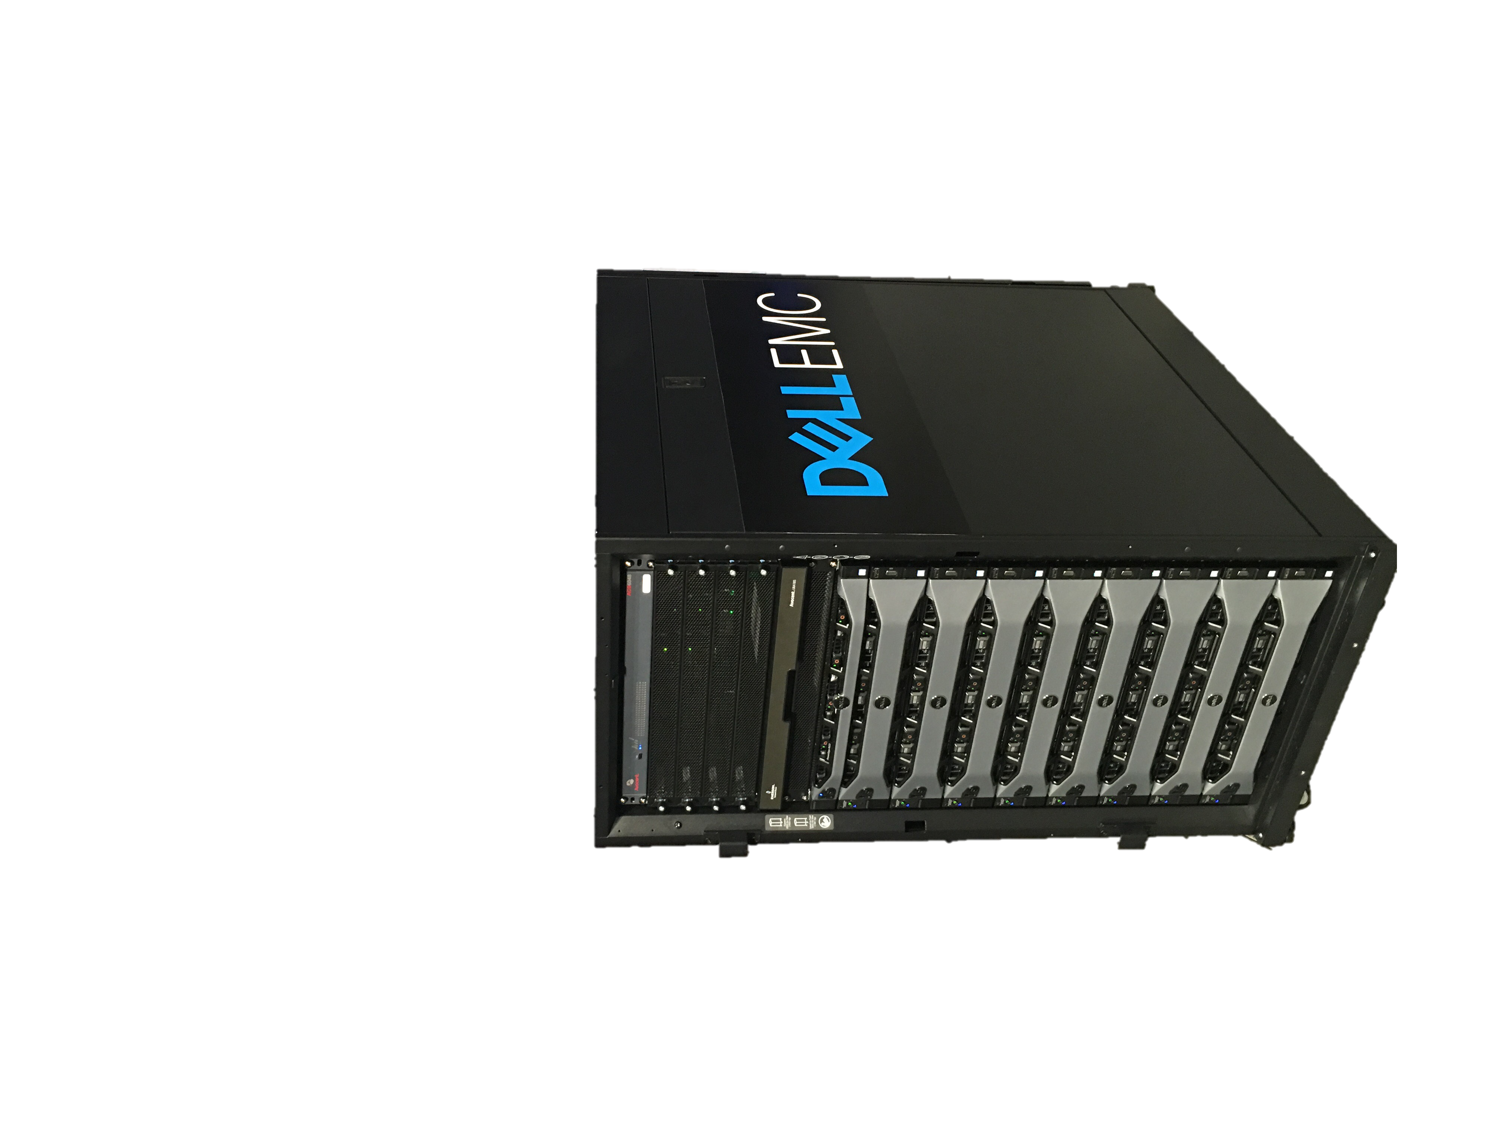
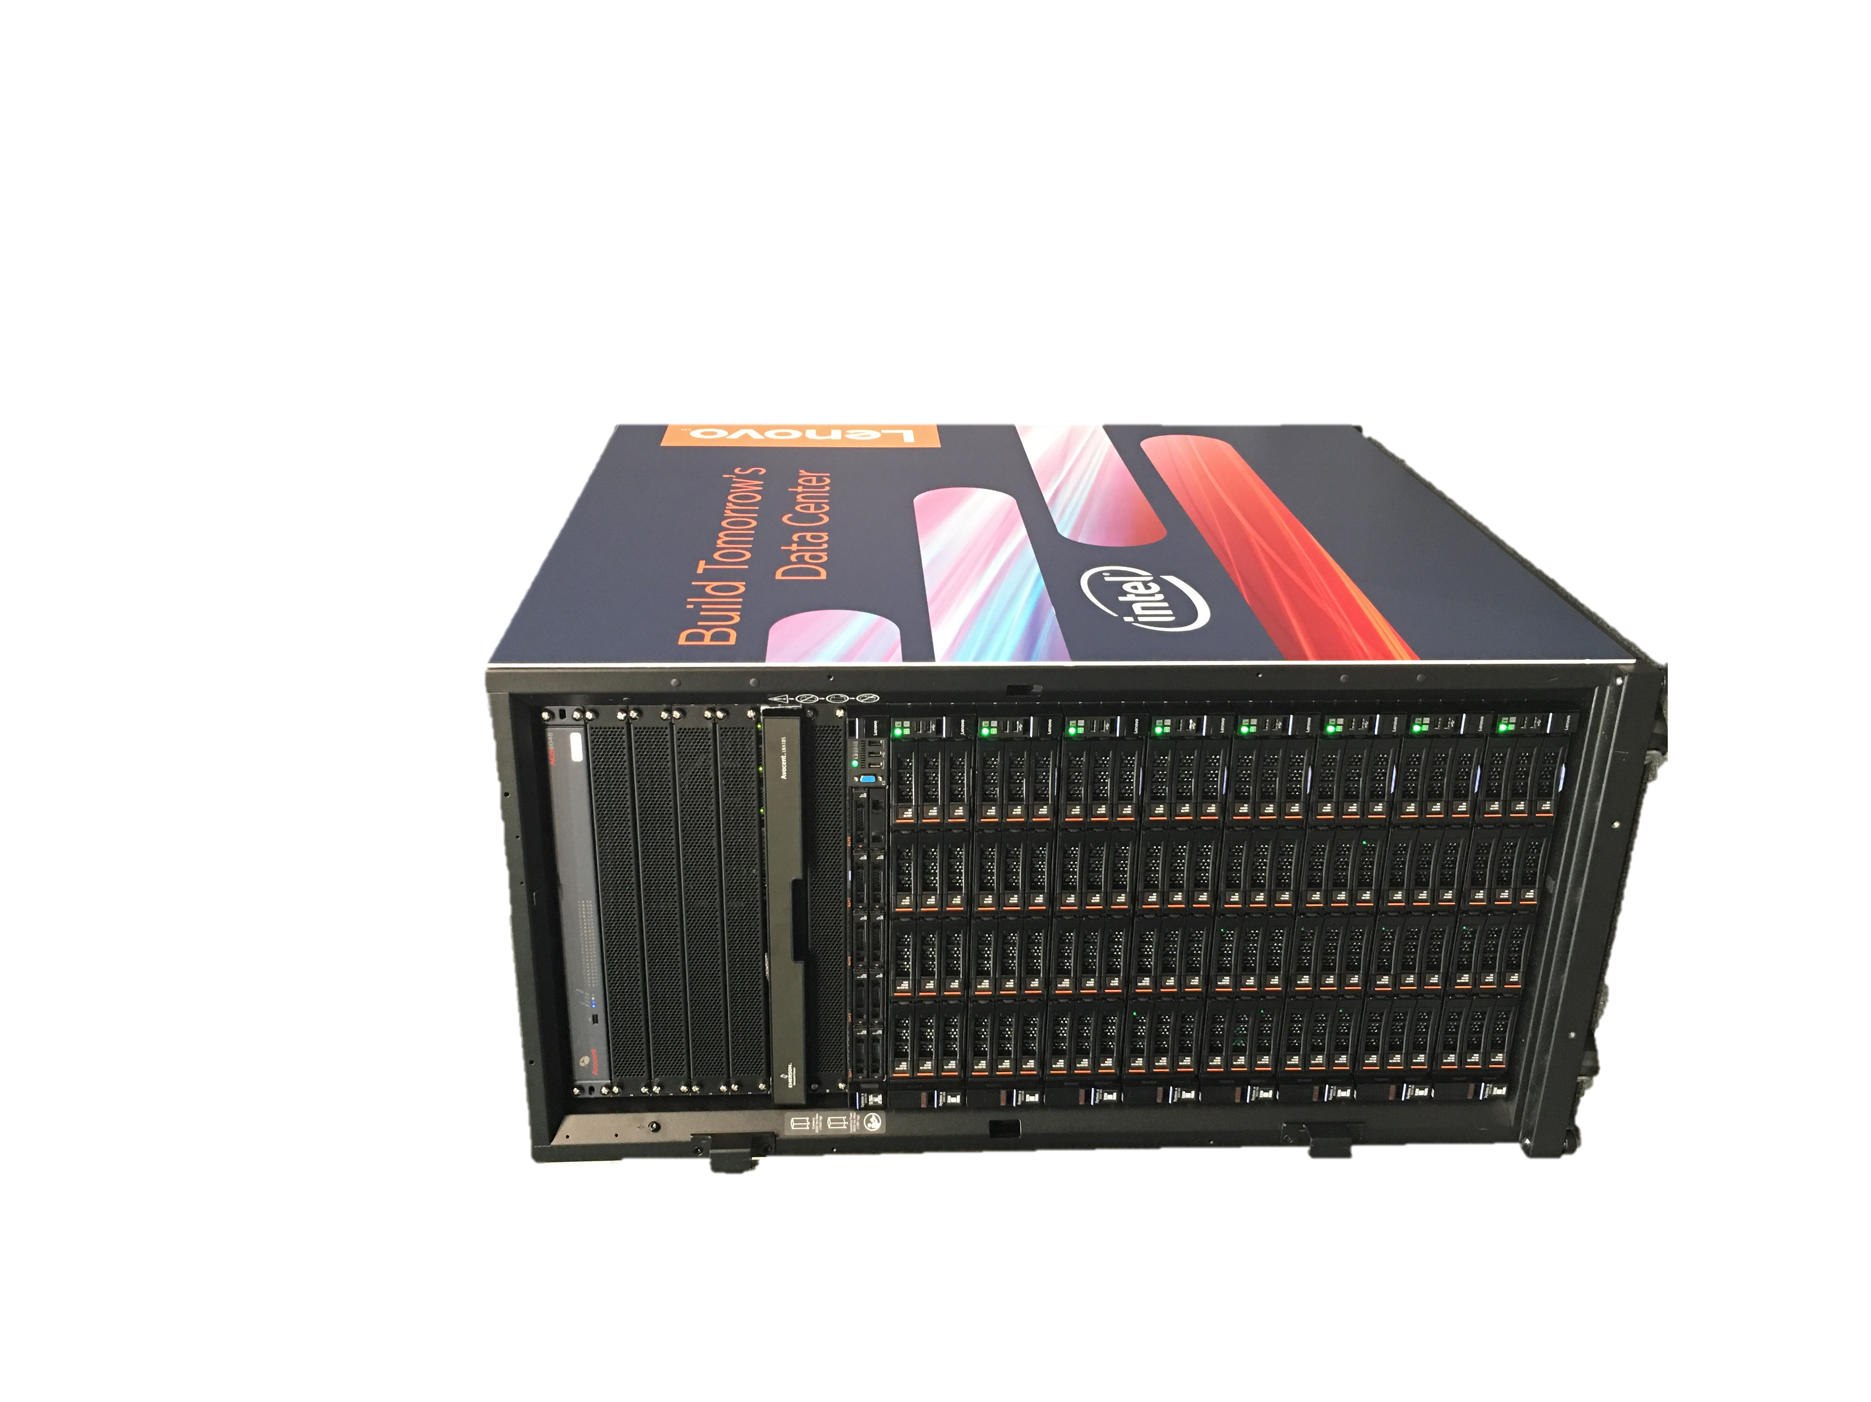
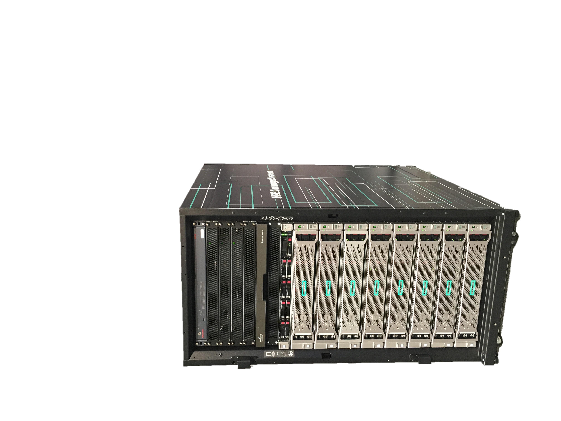



Slide 11
POC System Requirements
Component | Minimum | Recommended | Vendor Systems
Disk drives: Operating System | 1 OS disk with minimum of 200 GB available for system partition (SSD or HDD) | 1 OS disk with minimum of 200 GB available for system partition (SSD or HDD) | Dell R630
Disk drives: General Azure Stack POC Data* | 4 disks. Each disk provides a minimum of 140 GB of capacity (SSD or HDD). All available disks will be used. | 4 disks. Each disk provides a minimum of 250 GB of capacity (SSD or HDD). All available disks will be used. | HP DL360
Compute: CPU | Dual-Socket: 12 Physical Cores (total) | Dual-Socket: 16 Physical Cores (total) | Lenovo x3650 M5
Compute: Memory | 96 GB RAM | 128 GB RAM (This is the minimum to support PaaS resource providers.)
Compute: BIOS | Hyper-V Enabled (with SLAT support) | Hyper-V Enabled (with SLAT support)
Network: NIC | Windows Server 2012 R2 Certification required for NIC; no specialized features required | Windows Server 2012 R2 Certification required for NIC; no specialized features required
HW logo certification | Certified for Windows Server 2012 R2 | Certified for Windows Server 2012 R2

Slide 12
Demo

Slide 13

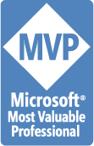



Rik Hepworth
IT Director, Black Marble
MVP (Azure)
@rikhepworth
github.com/rikhepworth
blogs.blackmarble.co.uk/blogs/rhepworth

Slide 14
Useful Links
Get the Technical Preview https://azure.microsoft.com/overview/azure-stack/
Azure Stack Documentation https://docs.microsoft.com/en-us/azure/azure-stack/
Dell Cloud Blog (for POC) http://en.community.dell.com/techcenter/cloud/b/dell-cloud-blog/
Lenovo POC https://lenovopress.com/lp0620-azure-stack-proof-of-concept-on-the-lenovo-x3650-m5-server
HP Azure Stack https://www.hpe.com/us/en/solutions/cloud/azure-hybrid-cloud
AzureStack Quickstart Templates https://github.com/Azure/AzureStack-QuickStart-Templates
AzureStack Blog https://github.com/Azure/AzureStack-QuickStart-Templates

